Slide 1
CO4127
Lecture 1 - Introduction to HTML
and Web Technologies

Slide 2
Today
A brief history of HTML
HTML document structure
The correct doctype
Tags / Elements
Page structure
Simple HTML tags
Approach to writing HTML
Standards
HTML checklist
The most basic tags
Headings
Paragraphs
Lists
Tables
Short demo of what we covered

Slide 3
A brief history of HTML

Slide 4

A brief history of HTML
HTML stands for HyperText Markup Language
Tag-based language
Invented by Tim Berners-Lee at CERN in the 1990s
Initially released in 1993
Extensible HTML released in 2000 (XHTML)
Current version: HTML5
It is a standard

Slide 5
HTML Document Structure

Slide 6
HTML tags
An HTML document is a plaintext document structured with elements
Elements are surrounded by matching opening and closing tags. Each tag begins and ends with angle brackets (<>)
You can extend HTML tags with attributes, which provide additional information affecting how the browser interprets the element

Slide 7
HTML tags
Content
Opening tag
Closing tag
<p>Hello World!</p>
Element
Tags are the bread and butter of HTML

Slide 8
Minimum requirements (basic HTML structure)
Doctype declaration
An instruction associating our document with a document type definition (DTD)
Head
Contains page title, meta-data, links to external styles and scripts.
Nothing in head is rendered onto a webpage (Except the title and favicon - The page’s icon)
Body
The contents of body are rendered to the user as page content.
<!doctype html>
<html>
<head>
<meta charset="utf-8">
<title></title>
</head>
<body>
</body>
</html>

Slide 9
The correct doctype
This is the only doctype you should use in this course.
It defines your page as an HTML5 document.
<!doctype html>

Slide 10
Tags / Elements
All tags which display text content consist of an opening and closing tag.
Some tags do not require a separate closing tag. More on that later.
While the browser will still parse uppercase tags, tags should be lowercase.
<!-- Do -->
<p>Example paragraph</p>
<!-- Do not -->
<P>Example paragraph</P>

Slide 11
Page structure
Code should be clean and semantic (meaningful)
Map the content to the appropriate tags
Think about the content we want the user to see
How should we present this content (more on this later)
For example, if we want to display a heading, there is a subset of appropriate tags for that exact use. We’ll cover all sorts of semantic tags, your job is to match the correct tag to the correct content. That’s one of the secrets of good HTML code.

Slide 12
Simple HTML Tags

Slide 13
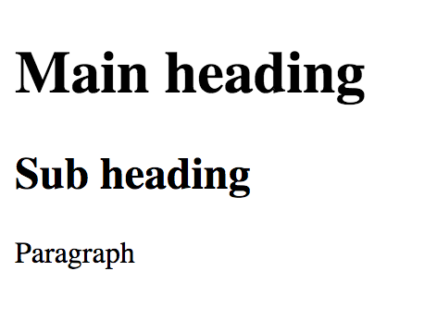
Simple HTML tags
<h1>Main heading</h1>
<h2>Sub heading</h2> <p>Paragraph</p>

Slide 14
Approach to writing HTML

Slide 15
Approach to writing HTML
HTML documents are just text documents with a different file extension.
They contain well structured and semantic markup.
There is an emphasis on standards.
Tags mostly come in pairs (opening/closing).

Slide 16
Standards
Why do we need structural and semantic code?
Finding blocks of meaningful code is significantly easier
Suggests to the developer the type of data that will be populated
Screen readers can use it as a signpost to help visually impaired users navigate a page
Why follow standards?
Browsers can interpret and display the contents and helps make More stable websites
Changes to design of whole sites can be made by only changing the CSS
Therefore, reducing development and maintenance time
Backward Compatibility / Rules all developers can follow

Slide 17
The most basic tags

Slide 18
Headings
Headings are usually the first textual elements we define. There are six heading levels.
That doesn’t mean you should use all of them. Generally, if you use any more than 4-5 levels, you should move content to new pages.
For valid HTML, every page must have an <h1> element.
<h1>Most important heading</h1>
<h6>Least important heading</h6>

Slide 19
Paragraphs
Paragraphs are for text.
Don’t forget to close!
<p>Some text</p>
<p>Some more text</p>

Slide 20
Lists
Unordered Lists <ul> are typically bulleted.
Ordered Lists <ol> are typically numbered.
List Items are denoted by <li>.
<ul>
<li>List item</li>
<li>List item</li>
</ul>
<ol>
<li>List item</li>
<li>List item</li>
<ol>

Slide 21
Tables
Tables are for data.
Do not structure your HTML documents with tables!
The <table> tag encloses the entire table.
A <tr> tag denotes a row.
A <td> tag denotes a cell.
There are lots more table related tags
<table>
<tr>
<td>Data cell</td>
<td>Data cell</td>
</tr>
</table>

Slide 22
Quick demo

